Slide 1
Amazon Virtual Private Cloud (VPC)
Amazon Virtual Private Cloud is a commercial cloud computing service that provides users a virtual private cloud, by provisioning a logically isolated section of Amazon Web Services Cloud.
Amazon Virtual Private Cloud (Amazon VPC) lets you provision a logically isolated section of the AWS Cloud where you can launch AWS resources in a virtual network that you define.
You have complete control over your virtual networking environment, including :
selection of your own IP address range
creation of subnets
configuration of route tables and network gateways.

Slide 2
Classless Inter-Domain Routing(CIDR)
Classless Inter-Domain Routing is a method for allocating IP addresses and for IP routing.
The Internet Engineering Task Force introduced CIDR in 1993 to replace the previous classful network addressing architecture on the Internet.
CIDR is principally a bitwise, prefix-based standard for the representation of IP addresses and their routing properties.
It facilitates routing by allowing blocks of addresses to be grouped into single routing table entries.
These groups, commonly called CIDR blocks, share an initial sequence of bits in the binary representation of their IP addresses.

Slide 3
Classless Inter-Domain Routing(CIDR)
An IP address is part of a CIDR block and is said to match the CIDR prefix if the initial n bits of the address and the CIDR prefix are the same.
An IPv4 address is 32 bits so an n-bit CIDR prefix leaves 32 − n bits unmatched, meaning that 2^{32 − n} IPv4 addresses match a given n-bit CIDR prefix.
Shorter CIDR prefixes match more addresses, while longer prefixes match fewer.

Slide 4
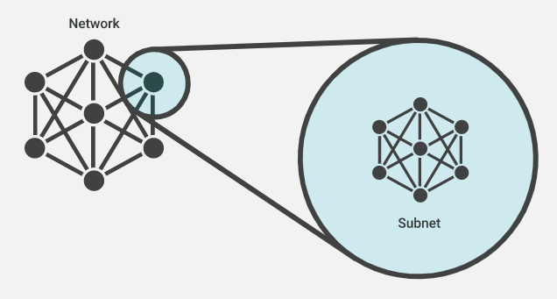
Subnetwork
A subnetwork or subnet is a logical subdivision of an IP network.
The practice of dividing a network into two or more networks is called subnetting.
Computers that belong to a subnet are addressed with an identical most-significant bit-group in their IP addresses.
A subnet, or subnetwork, is a network inside a network.
Subnets make networks more efficient. Through subnetting, network traffic can travel a shorter distance without passing through unnecessary routers to reach its destination.

Slide 5
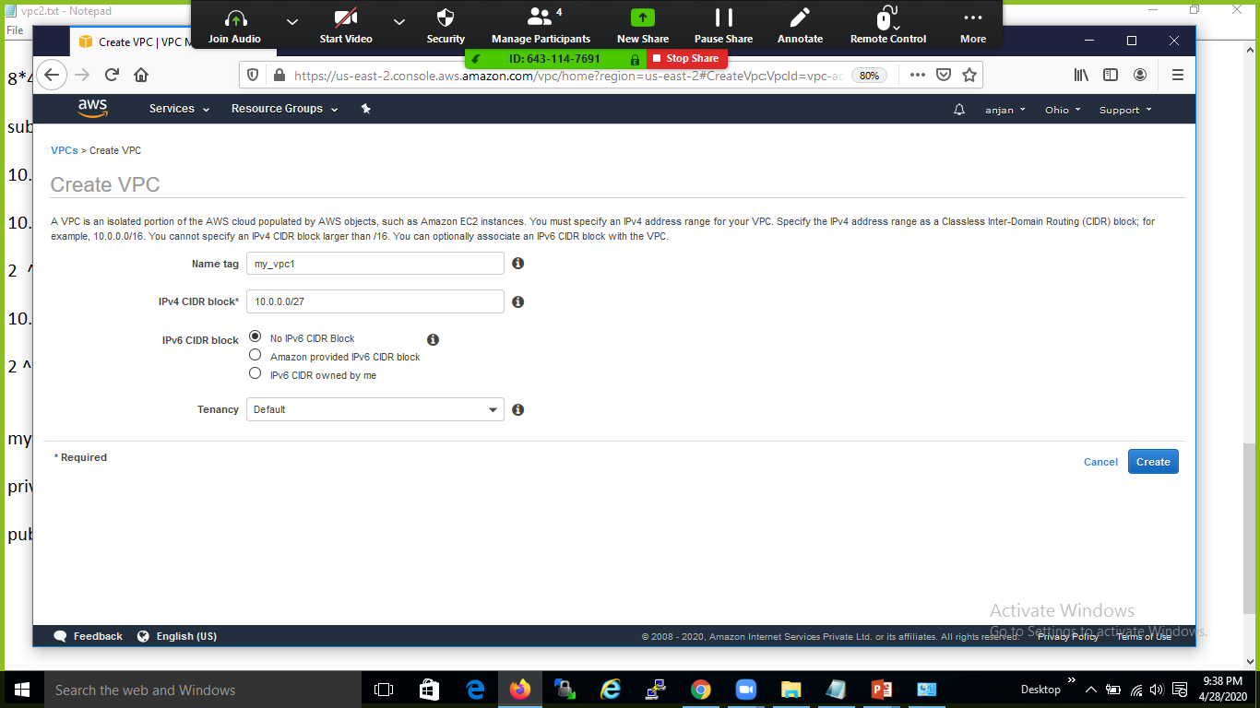

Slide 6
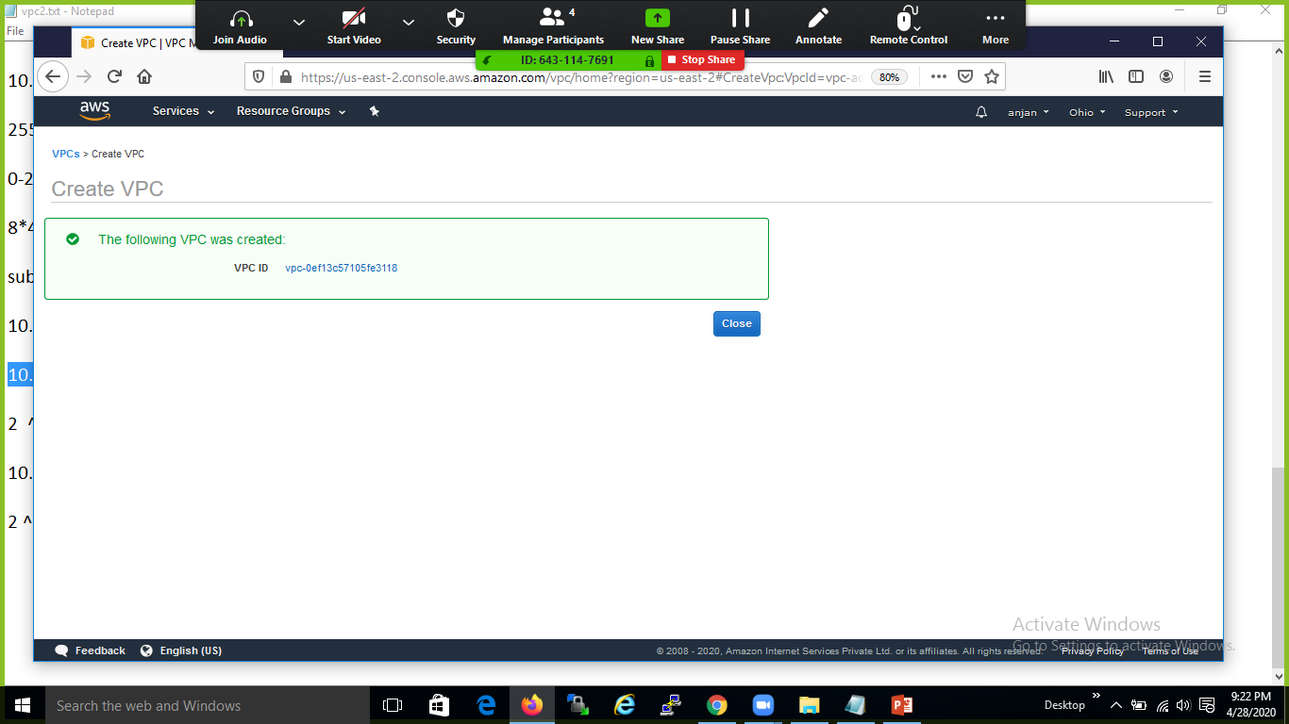

Slide 7
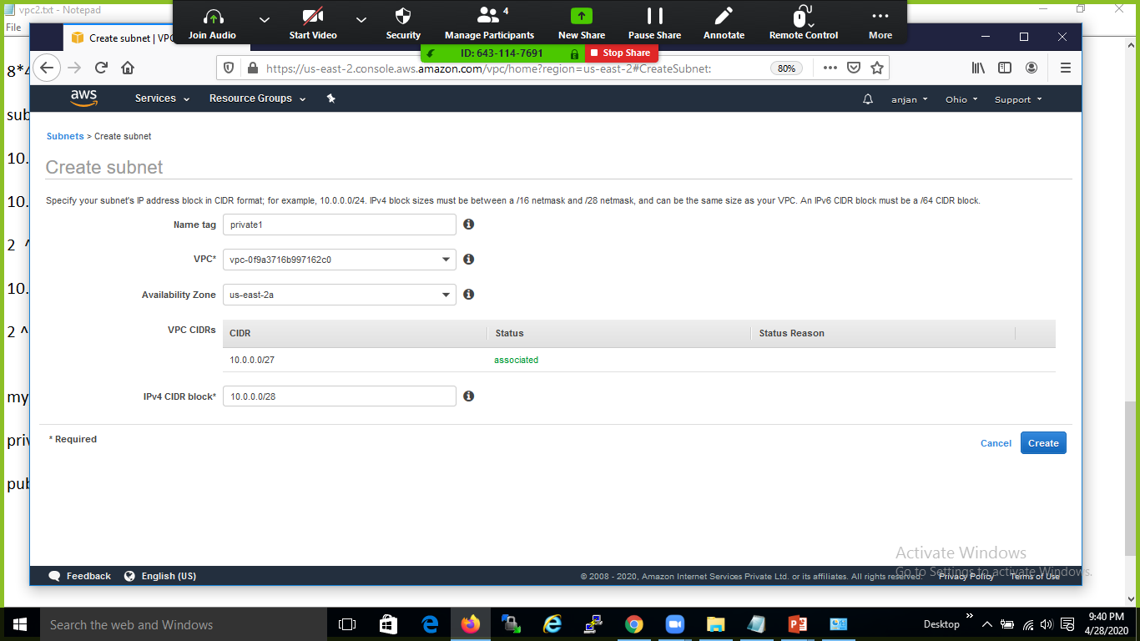

Slide 8
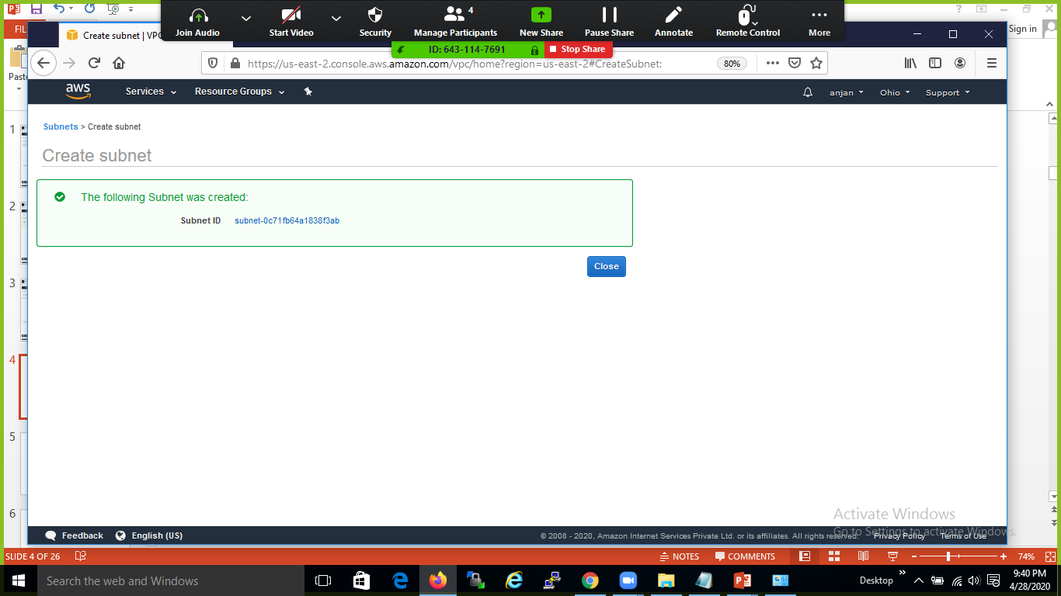

Slide 9
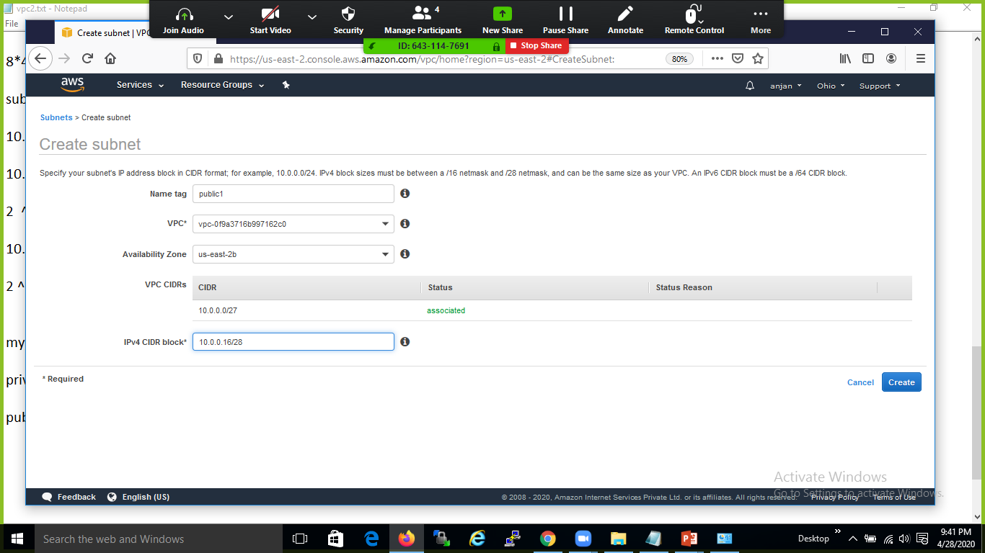

Slide 10


Slide 11
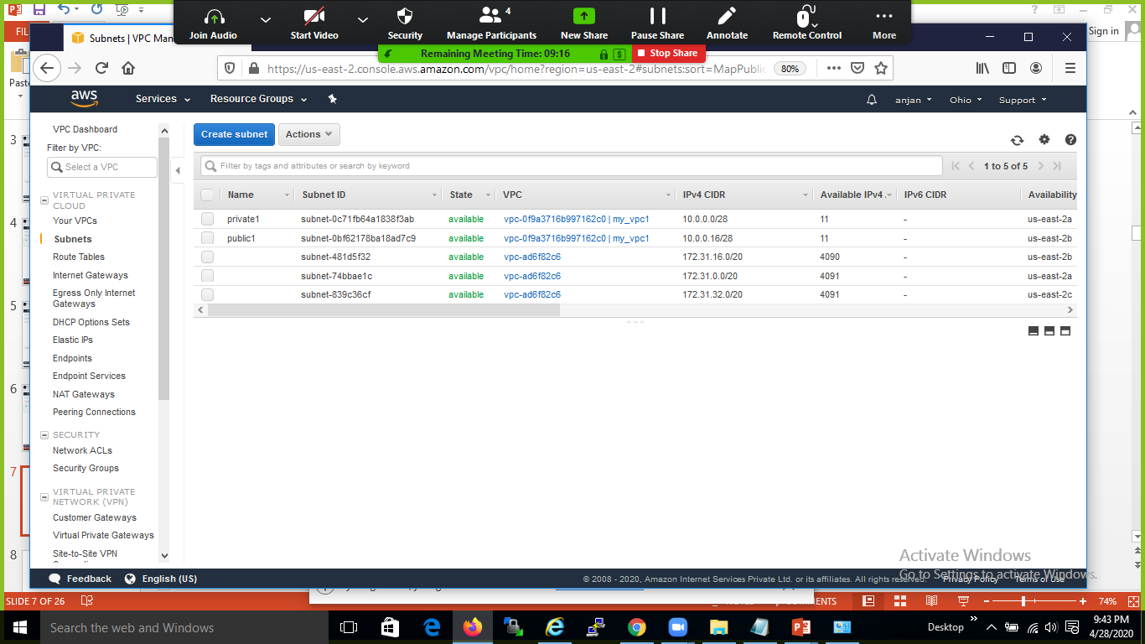

Slide 12
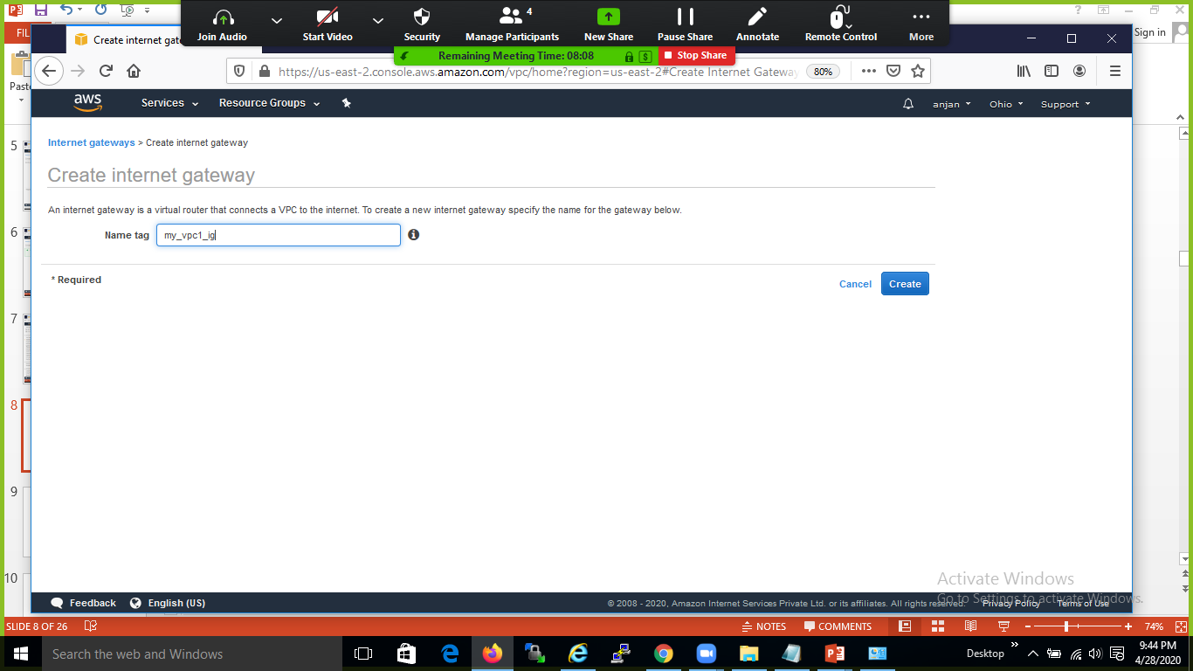

Slide 13
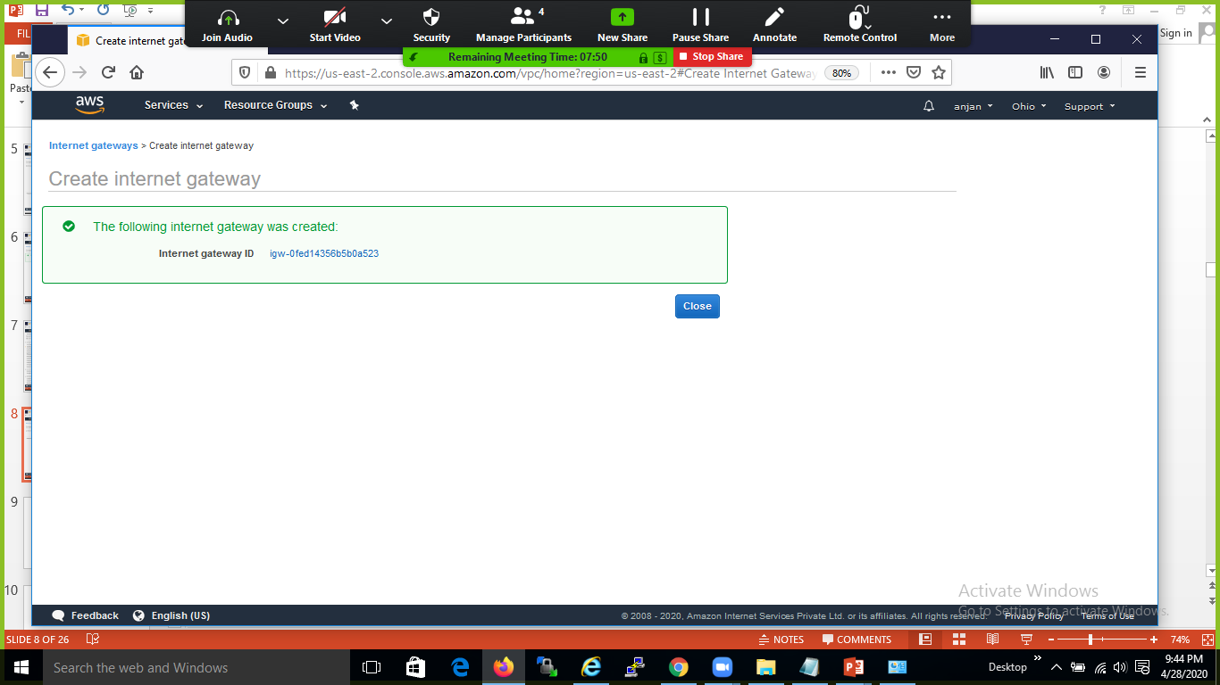

Slide 14
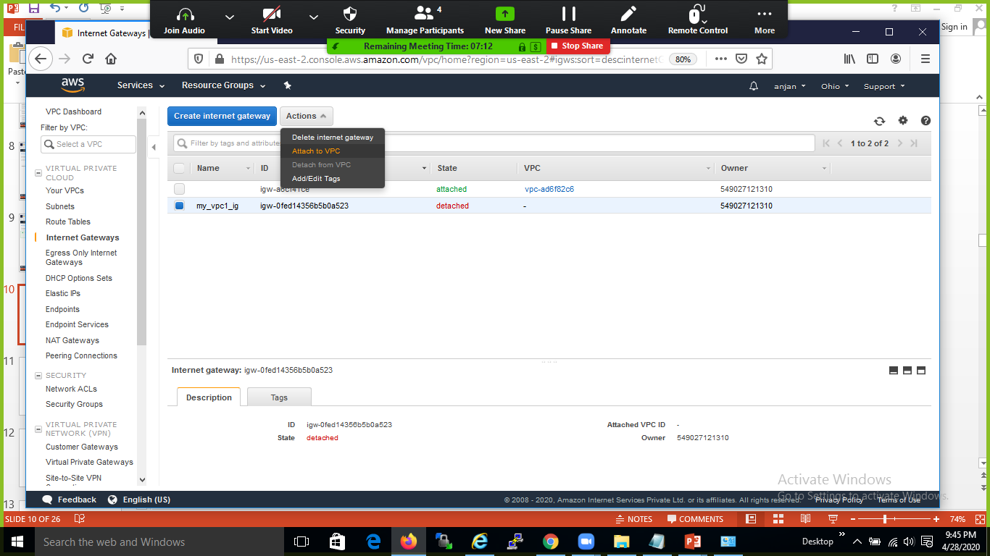

Slide 15
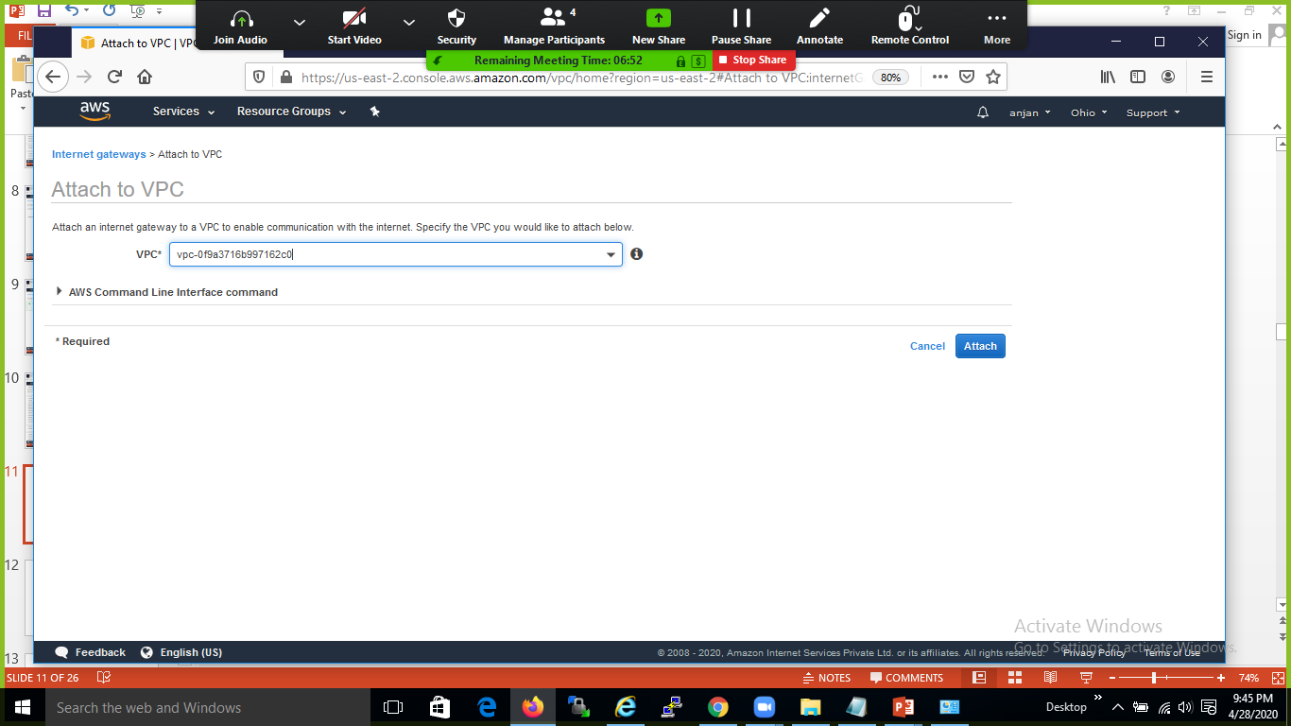

Slide 16
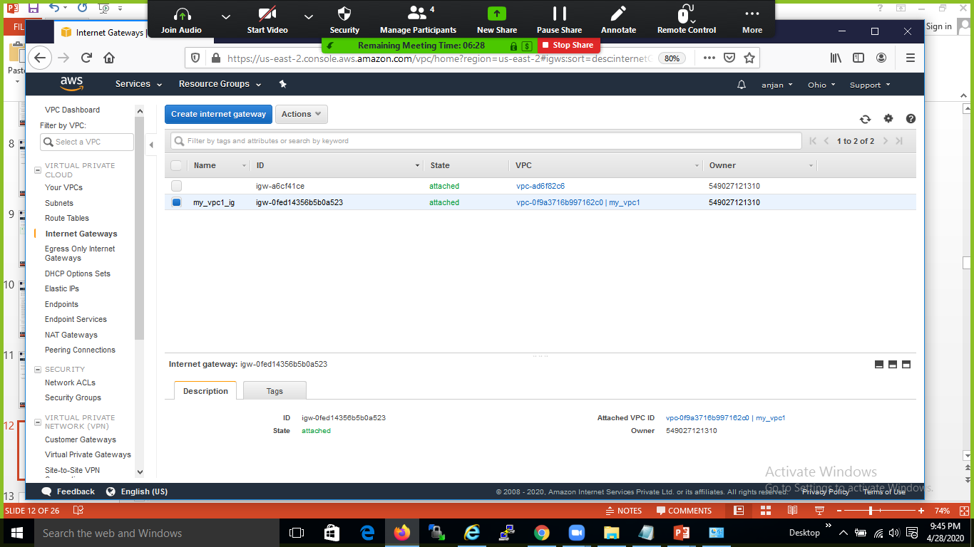

Slide 17
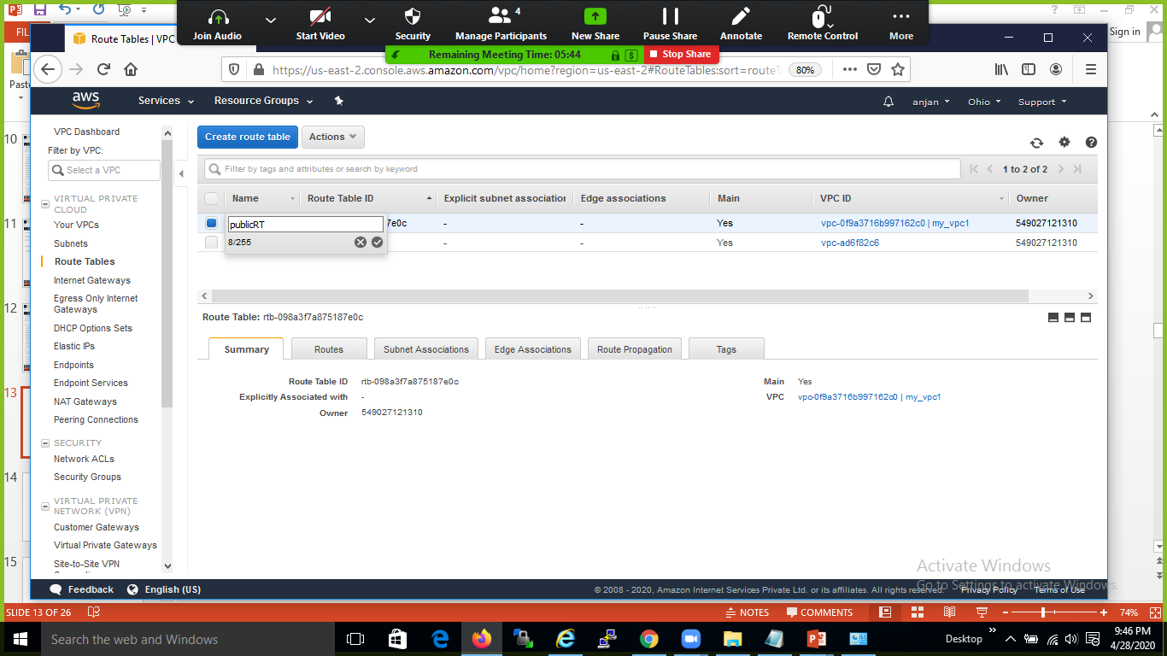

Slide 18
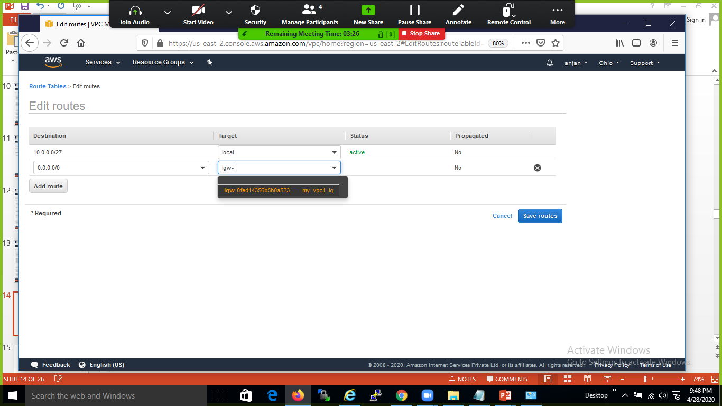

Slide 19
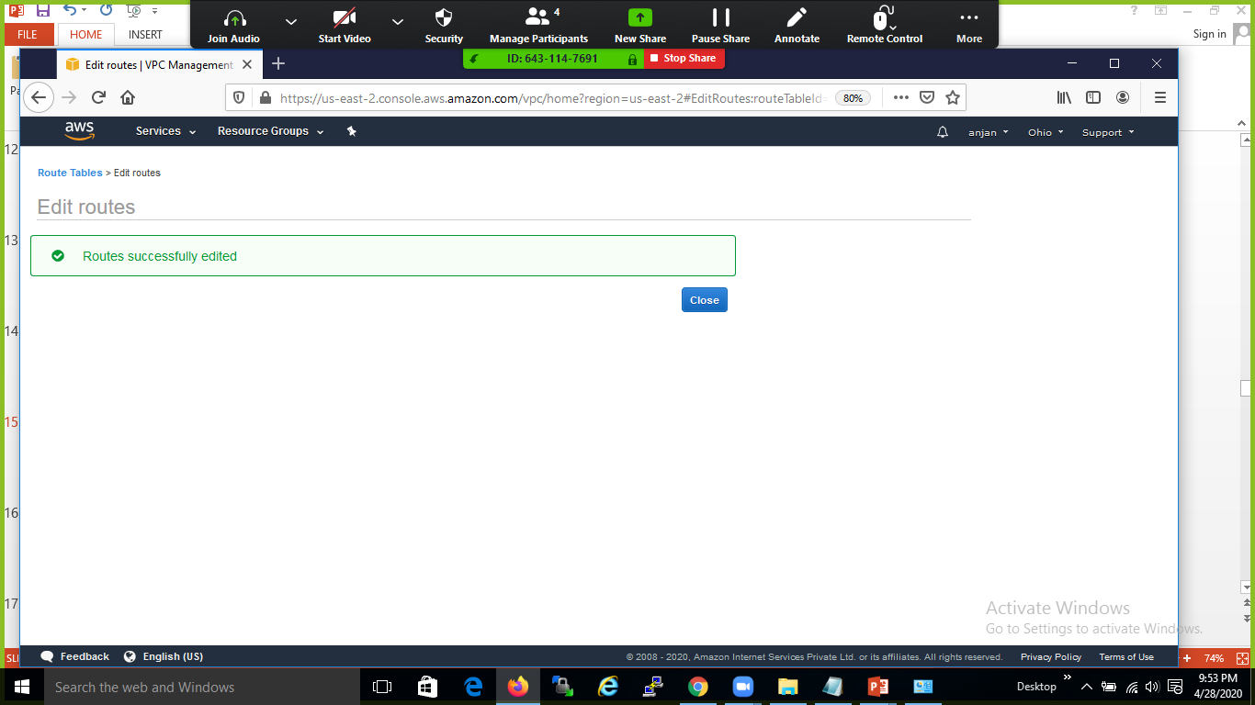

Slide 20
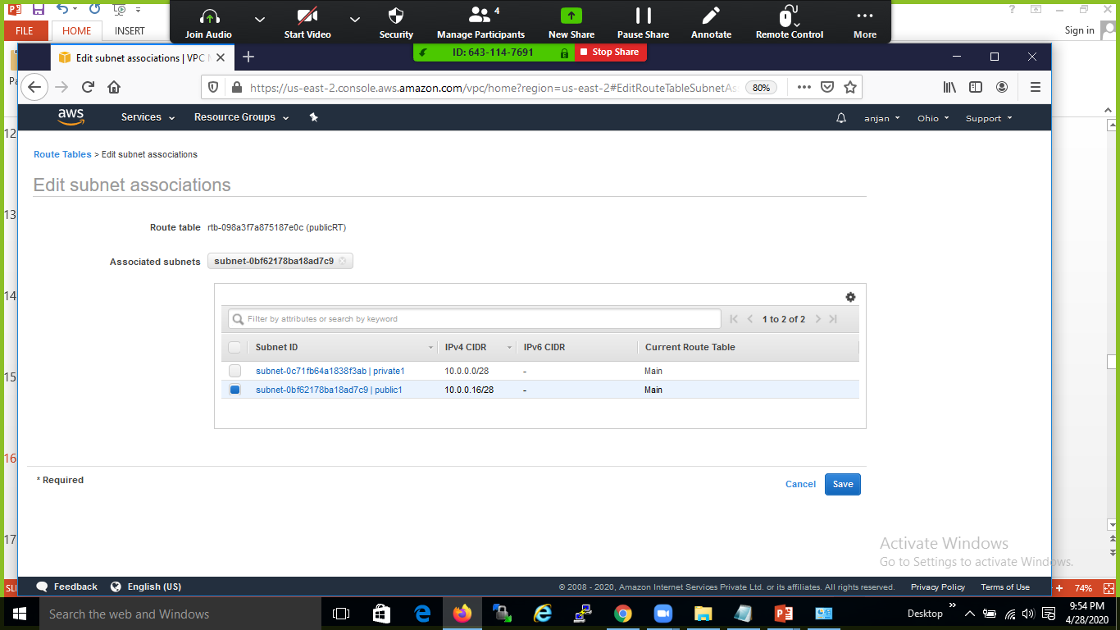

Slide 21
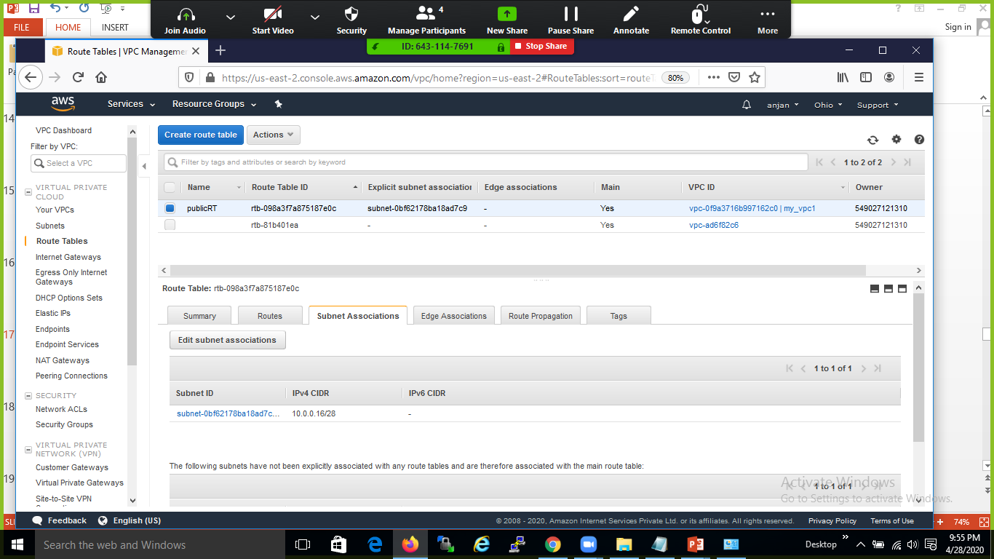

Slide 22
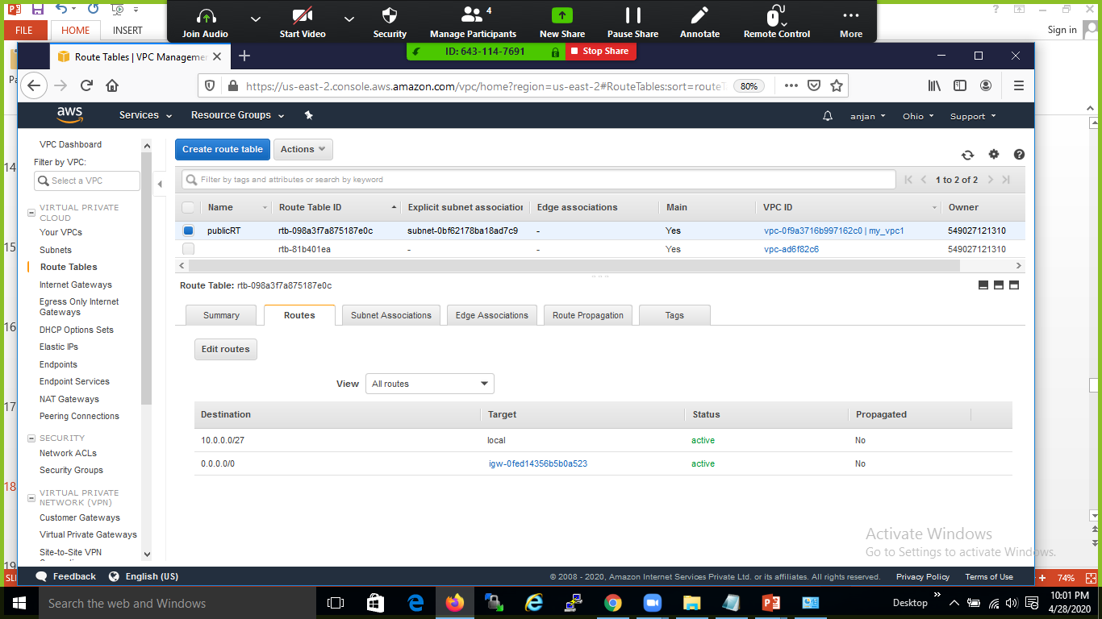

Slide 23
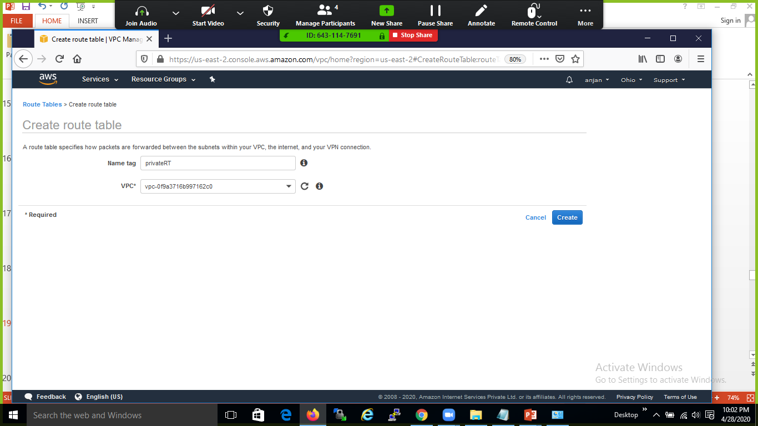

Slide 24
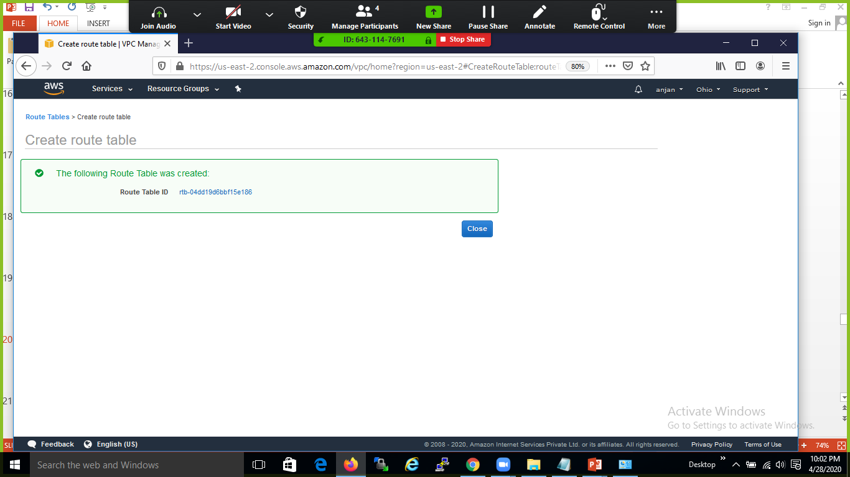

Slide 25


Slide 26
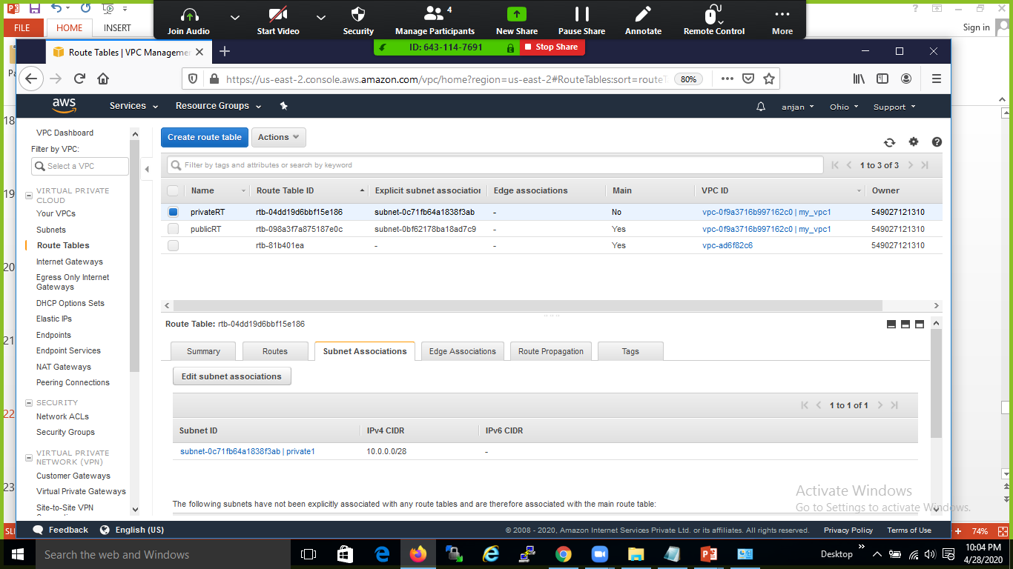

Slide 27


Slide 28
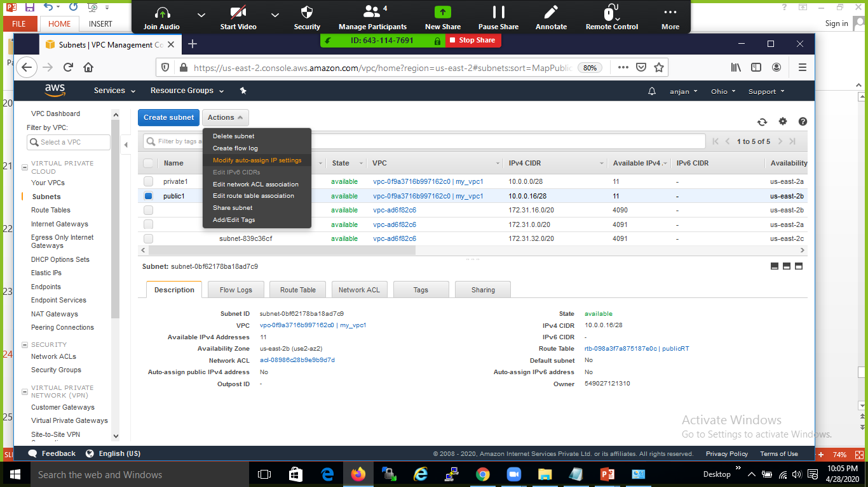

Slide 29
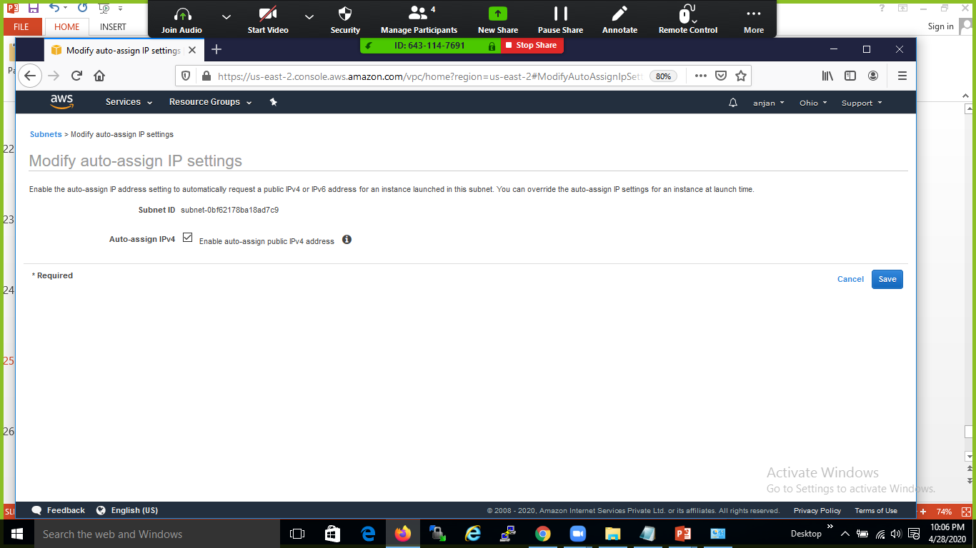

Slide 30
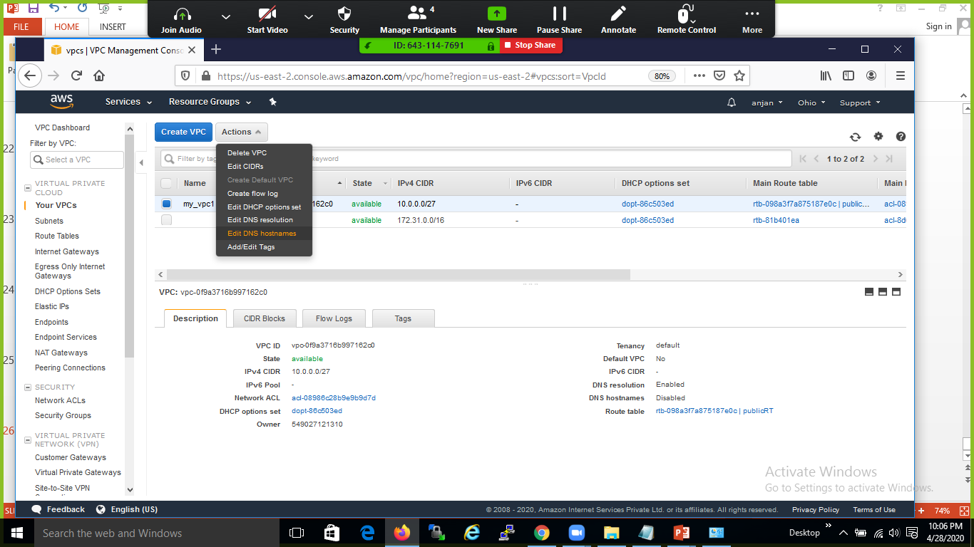

Slide 31
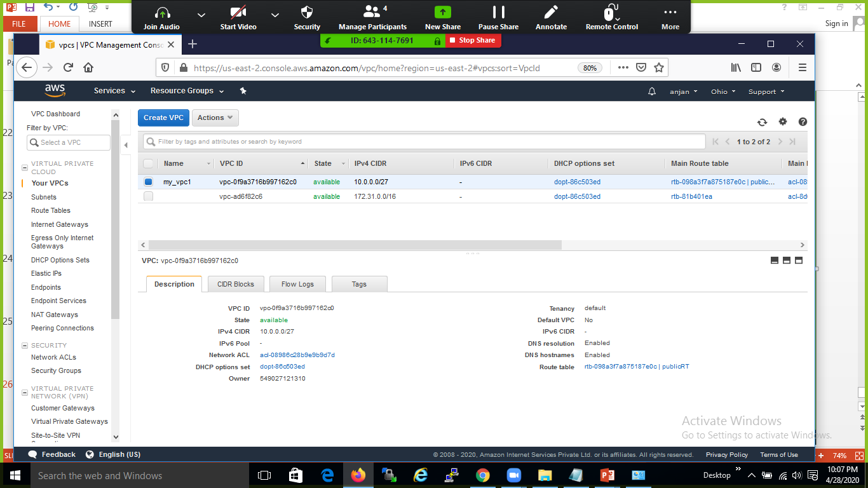

Slide 32
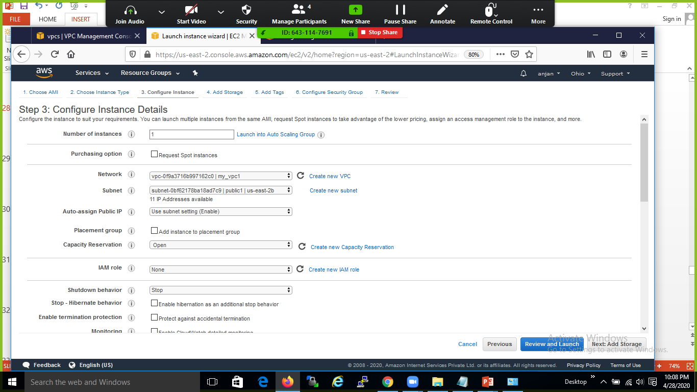

Slide 33
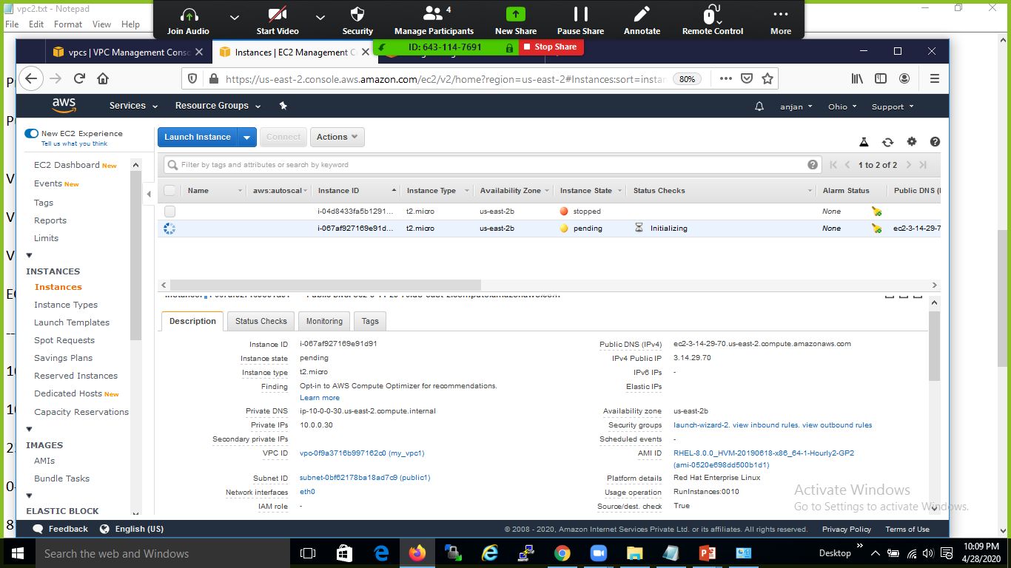

Slide 34
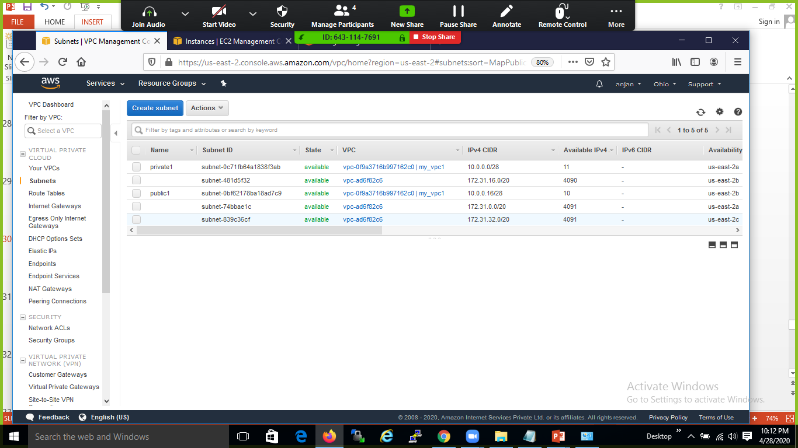

Slide 35
